Slide 1
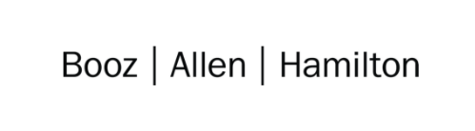

Cloud Excellence Presentation
Team 1
Members: Anjelique Butler Chris Mickey Harwinder Singh Kate Briggs Sarah Grimm
August 2021

Slide 2
TEAM 1: Project Web Application
Our Official Project for the Booze Allen Cloud Excellence Program
www.webagesolutions.com|1.877.517.6540

Slide 3





INTRODUCTIONS
ANJELIQUE BUTLER
Staff Technologist
CHRIS MICKEY
Staff Technologist
HARWINDER SINGH
Lead Technologist
KATE BRIGGS
Technologist
SARAH GRIMM
Technologist

Slide 4
Project
Introductions
Project Overview
Architecture/Design diagram
Tools/Software Environment used
Challenges/Issues/Problems/Your stories
What have you learned/learned?
What else can we do on the project? - future plan- any design and implementation ideas?
Demo
Questions and answers
International Pet Players
Web Application
www.webagesolutions.com|1.877.517.6540

Slide 5
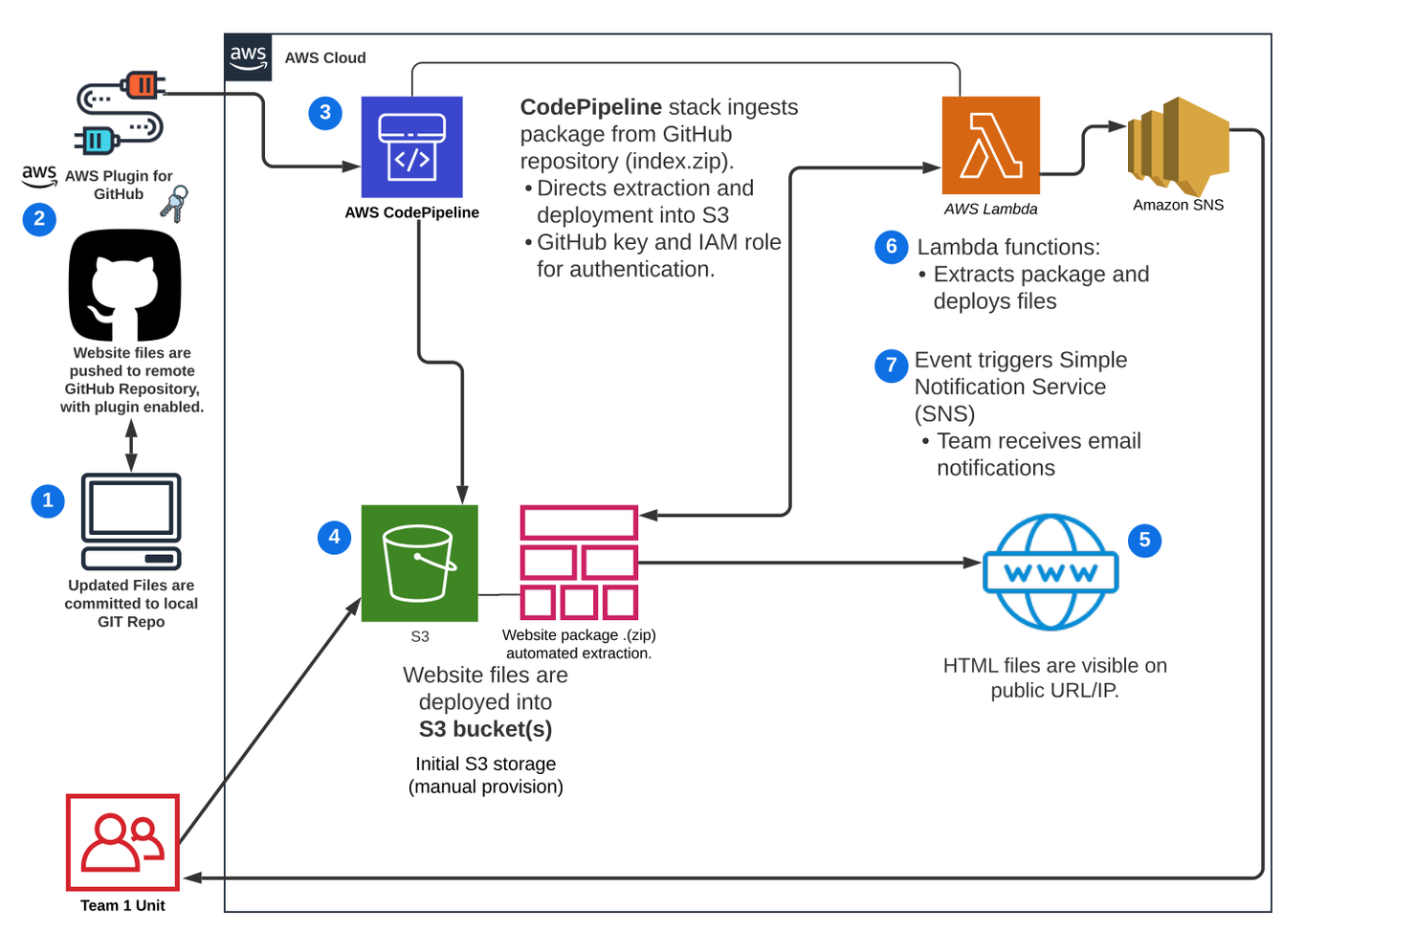
Architecture and Design

Slide 6
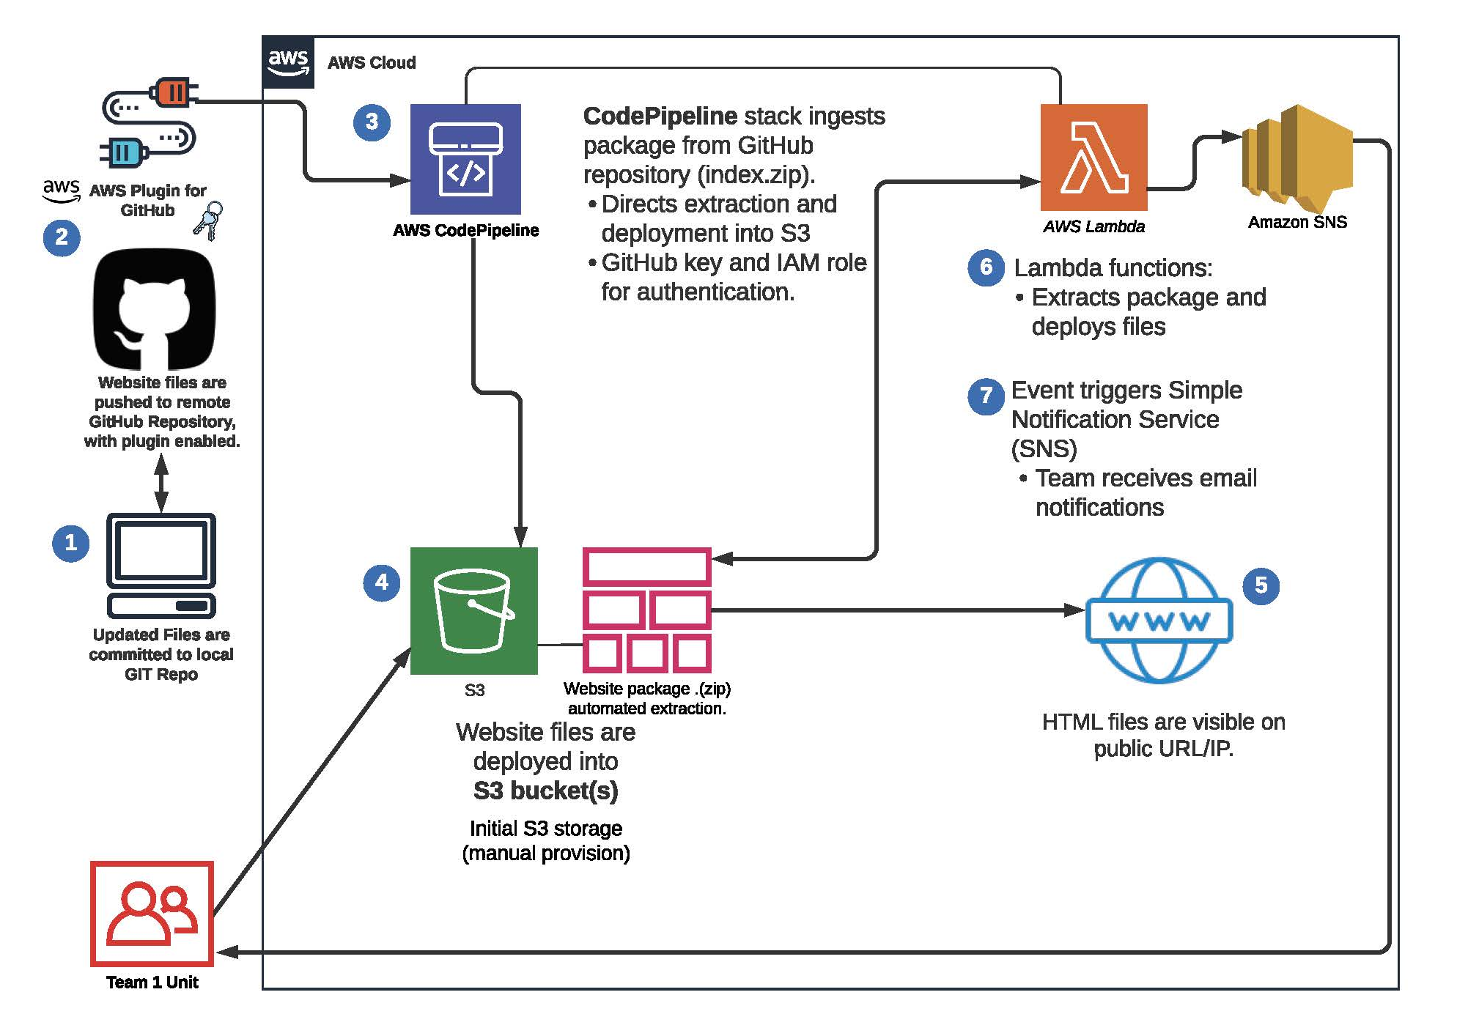

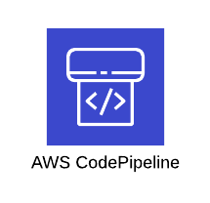

Technologies and Environment used
FEATURE | DESCRIPTION
AWS IAM | AWS identity and access management (IAM) tool for users, groups, roles and access
AWS S3 | AWS cloud storage feature, Serverless Storage Service (S3).
AWS CodePipeline | Service used to automate code deployments
AWS SNS | Simple Notification Service for enabling event-driven alerts
AWS Lambda | Serverless web service that can execute functions in python, Javascript, etc. (prebuilt or custom)
AWS CloudWatch | AWS event monitor used to view logs for infrastructure and account activity
Git with GitHub | Repository for website code and related files.
GitHub
Notes:
IAM – This feature was used to add our personal user accounts, security groups, roles and policies.
S3 – We have stored our static webpage on this serverless feature
CodePipeline – Used this feature instead of Jenkins to simplify our process as it is already within AWS and we did not have any code to be built.
SNS – this notification is triggered by lambda function and sends email to those subscribed, to inform anytime there is an update to bucket
Lambda – we used this feature to add a function that receives Zipfile from CodePipeline and extracts it before deploying to s3
CloudWatch – used to view logfiles and account activity
GitHub – where we chose to keep our remote repository to store all artifacts for project

Slide 7
Issues and Challenges
Issues
How to be realistic about security early in the development process
Overwhelming number of services to choose from and the different options for infrastructure
Challenges
Getting everyone set up with Git properly, some using desktop app and others CLI
Received error when trying to add SNS notification and had to troubleshoot permissions between services
Researched how to reduce number of notifications received when pipeline runs
The sensitivity of the configuration sequence and how timeouts can result in lost work

Slide 8
Lessons Learned
Take aways…
When adding users, download csv right away with credentials because otherwise if screen times out, you lose session and information is gone.
S3 bucket must be in same region as pipeline when using CodePipeline
We could not see pipeline after initial execution. We realized in a different region when pipeline created and that we all need to make sure we are in the same region!
S3 bucket has to be created after SNS topic in order for notifications to work
Filter your S3 notifications!

Slide 9
Demo

Slide 10
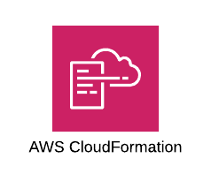

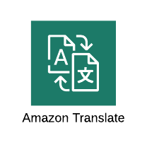



Future State - What we would add
Run Test Script
Create Temporary Resources
Run Test on Temporary Stack
Pipeline for Testing Website
Create automated test script (potentially in Cloud Formation) that would deploy an S3 bucket on demand, to test website functionality
User-driven features
Implement automated web services that generate output on webpage in response to user data
E.g., webpage language could be updated based on user location
SNS notification for infrastructure monitoring
Automated alerts based on resource utilization or cost, etc.
Enhanced user experience
User Alerts
App Alerts
Network Alerts

Slide 11
Q & A - Ask us anything

Slide 12
Thank you!!!
August 2021

